Slide 1


AIRLINE RESERVATION SYSTEM
C-DAC ADVANCED COMPUTING TRAINING
SCHOOL ATC,NETCOM JAIPUR
Under Guidance of
Prof. NISHANT SIR
PGDAC Batch : Sep 2021
BY:
1.ROHIT SACHAN
2.VISHANT MORI
3.AKASH YALMAR
4.SIDDHANUJA KAMBLE
5.RASHMI SONKUSARE

Slide 2
CONTENT
INTRODUCTION
PROBLEM DEFINAITION
OBJECTIVES
TOOLS AND PLATFORM USED
ANALYSIS
SOFTWARE ENGINEERING APPROCH
SYSTEM DESIGN
TESTING
ADAVANTAGES AND DISADVANTAGES

Slide 3
INTRODUCTION
. The Airline Ticket Booking System (ATBS) was one of the earliest changes to improve efficiency. ATBS eventually evolved into the Computer Reservations System (CRS), and then into Global Distribution System (GDS). The airline industry created the first GDS in the 1960s as a way to keep track of flight schedules, availability, and prices. Although accused of being “dinosaurs” due to their use of legacy system technology, GDSs were actually among the first e-commerce companies in the world facilitating B-2-B electronic commerce as early as the mid 1970s, when SABRE (owned by American Airline) and Apollo (United) began installing their propriety internal reservations systems in travel agencies.

Slide 4
PROBLEM DEFINAITION
In 21st century the world has become a global village where every thing is available in a single click of mouse button. Aviation sector is one of fastest mode of travel available with us, both at domestic and international level. To maintain such a large system is a hectic job. The present system is very time consuming and inefficient.
The definition of our problem lies in manual system and a fully automated system.
Manual system : The system is more prone to errors and some times it encounters various problems which are unstructured.
Technical system : With the advent of latest technology if we do not update our system then our business will suffer massive losses financially. The technical system (we have proposed) contains the tools of latest trend i.e. computers printers, fax etc. The systems with this technology are very fast, accurate, user-friendly and reliable.

Slide 5
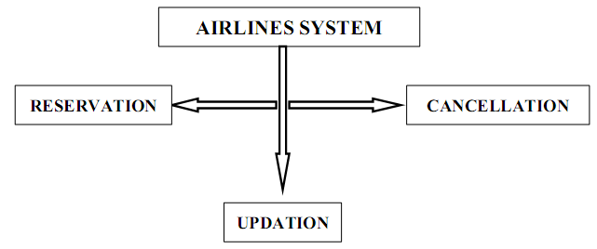
Need of Airlines system A few factors that direct us to develop a new system are given below -: 1) Faster System 2) Accuracy 3) Reliability 4) Informative 5) Reservations.

Slide 6
OBJECTIVES
To develop a system to management of airlines, this will perform all the functions with a click of mouse button’s
To develop a system that has good management of data along with integrity and minimizing redundancy.
To develop a system that will be user friendly in all possible ways.
To provide better customer support for passengers.

Slide 7
TOOLS AND PLATFORM USED
Programming Languages:- In programming language we have Java, JDBC, jsp, Servlet, SQL etc.
Relational Database: -MYSQL, SQL Server, etc.
Software Requirements
HARDWARE SPECIFICATIONS
Processor : Intel Pentium or more
Ram : 128 MB or more
Cache : 512 KB
Hard disk : 16 GB hard disk recommended
Operating System | Windows
Front End | CSS, JSP, HTML
Back End | JAVA Servelet JDBC

Slide 8
ANALYSIS DFD for Airline Reservation System

Slide 9
ENTER USERNAME
PASSWORD
VERIFIY USERNAME PASSWORD
Airline Reservation
System
SYSTEM
ADMINSTRATOR
Log In
User Name
Verificaion
Success
Password Verification
Verification
Fail
EXIT FROM
SYSTEM

Slide 10
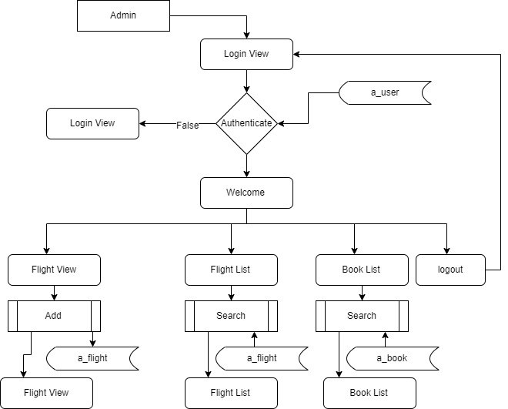
Second Level of Data Flow Diagram for General Inquiry System

Slide 11
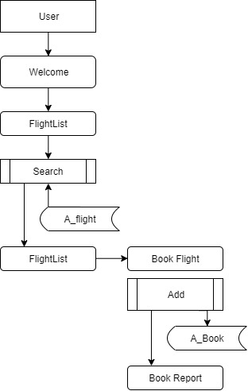
Third Level DATA FLOW DIAGRAM OF BOOKING SECTION

Slide 12
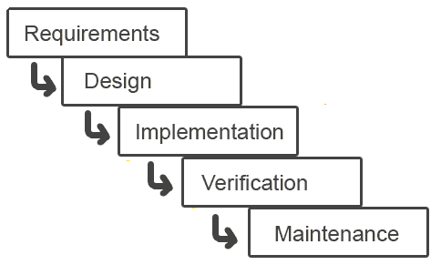
SOFTWARE ENGINEERING APPROACH
The field of software engineering is related to the development software in systematic manner unlike simple programs which can be developed in isolation and there may not be any systematic approach being followed. As there is large difference between programming and software engineering. As it provide models that lead to the production of well documented software in a manner that is predictable. For a mature process, it should be possible to determine in advance how much time and effort will be required to produce the final product. To develop successful software I have to follow some models, which act as guidelines.
The model I have used is Waterfall Model or Classic Life Cycle. In this model first of all the existed system is observed. Then customer requirements are taken in consideration then planning, modeling, construction and finally deployment

Slide 13
SYSTEM DESIGN
The process of system design can be divided into three stages. They are:
Structure design (already discussed)
Database design
Interface design
As we know that system design is a solution to “How to approach to the creation of new system”. It provides the understudying and procedural details necessary for implementing the system. The steps involved during system design were as follow: -
LOGICAL AND PHYSICAL DESIGN
The current physical system was thoroughly reviewed from point of view how the data flow, what are file contents, its volumes and frequency etc.
After this input, output specifications security & control specification were prepared. It was also decided that how physical information will flow through the system and a physical design walkthrough

Slide 14
SYSTEM DESIGN
OUTPUT DESIGN
The format of outputs is designed in such a way that it is simple to read and interpret In the present output we have clearly labeled title it contains date and time and all the fields are clearly mentioned (labeled).
INPUT DESIGN
.Input should be as simple as possible. It is design to reduce possibility of incorrect data being enter and the need of system user are considered with this view of mind several human factor is evaluated.
SCREEN DESIGN
The screen design for inputting the inputs were also panned as the format of inputs.

Slide 15
TESTING
Software Testing
Software testing is a process of verifying and validating that a software application or program. Software testing
1. Meets the business and technical requirements that guided its design and development, and
2. Works as expected.
Software testing also identifies important defects, flaws, or errors in the application code that must be fixed. The modifier “important” in the previous sentence is, well, important because defects must be categorized by severity.

Slide 16
Testing methods Software testing methods are traditionally divided into black box testing and white box testing. These two approaches are used to describe the point of view that a test engineer takes when designing test cases. Specification-based testing: Specification-based testing aims to test the functionality of software according to the applicable requirements. Thus, the tester inputs data into, and only sees the output from, the test object. This level of testing usually requires thorough test cases to be provided to the tester, who then can simply verify that for a given input, the output value (or behavior), either "is" or "is not" the same as the expected value specified in the test case

Slide 17
Black box testing Black box testing treats the software as a "black box"—without any knowledge of internal implementation. Black box testing methods include: equivalence partitioning, boundary value analysis, all-pairs testing, fuzz testing, model-based testing, traceability matrix, exploratory testing and specification-based testing.

Slide 18
Advantages & Disadvantages The black box tester has no "bonds" with the code, and a tester's perception is very simple: a code must have bugs. Using the principle, Ask and you shall receive," black box testers find bugs where programmers do not. But, on the other hand, black box testing has been said to be "like a walk in a dark labyrinth without a flashlight," because the tester doesn't know how the software being tested was actually constructed. As a result, there are situations (1) a tester writes many test cases to check something that could have been tested by only one test case. (2) some parts of the back-end are not tested at all. Therefore, black box testing has the advantage of "an unaffiliated opinion," on the one hand, and the disadvantage of "blind exploring," on the other.

Slide 19
THANK YOU....

